Slide 1

الوضع الوبائي للفيروس التاجي المستجد Epidemiology of 2019-nCoV
الجمهـوريــة اللبـنـانيــة
وزارة الصـحـة العامـة
برنامج الترصد الوبائي
27 شباط 2020

Slide 2
النقاط
البيانات العالمية
البيانات المحلية

Slide 3
البيانات العالمية

Slide 4
المصادر
www.who.int
www.emro.who.int
www.ecdc.europa.eu
www.cdc.gov
www.moph.gov.lb

Slide 5
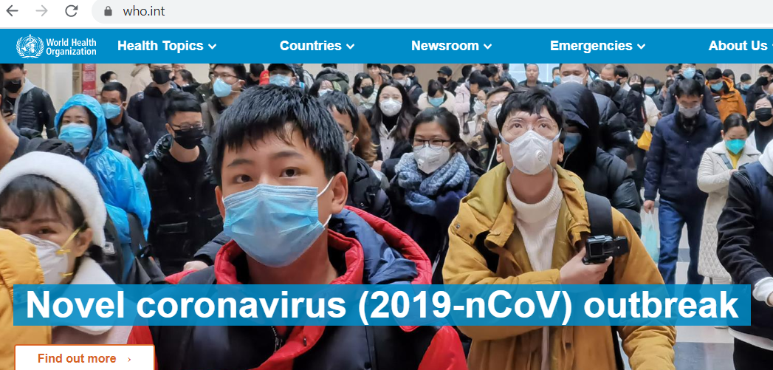
www.who.int

Slide 6
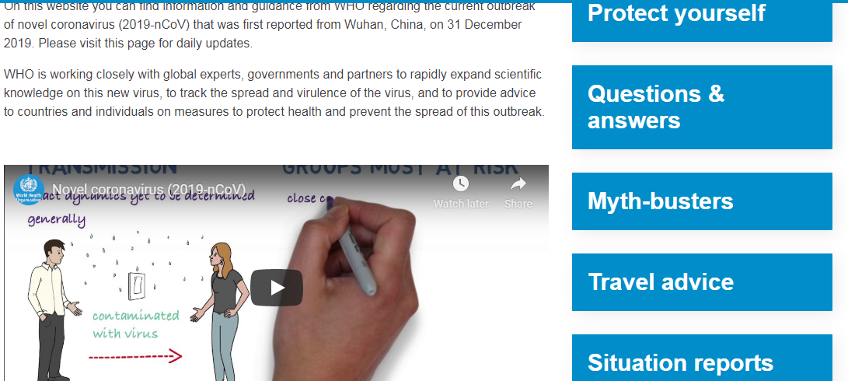
www.who.int

Slide 7
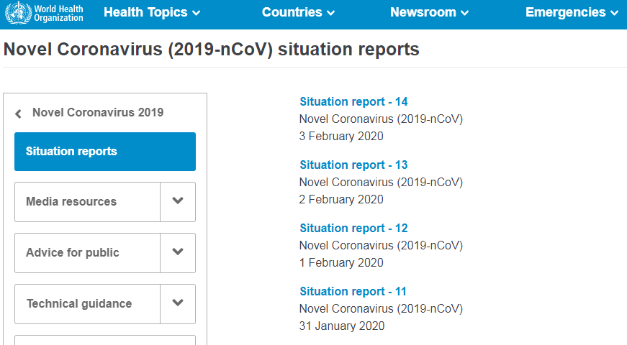
www.who.int

Slide 8
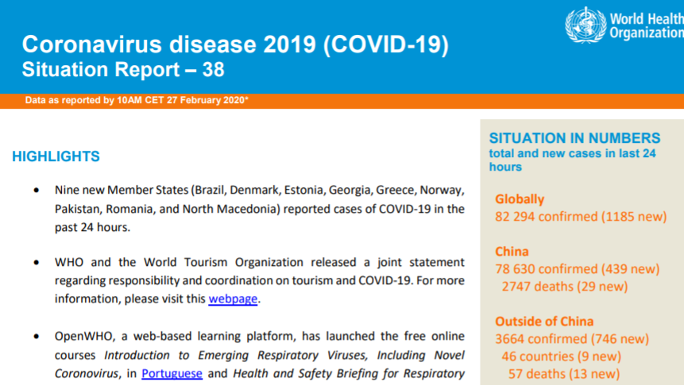
www.who.int Situation report #38

Slide 9
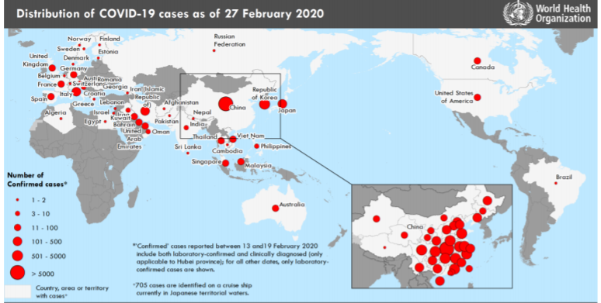
www.who.int Situation report #38 Cases on World map

Slide 10
www.who.int Situation report #38 Cases in China
Province | NB
Hubei Province | 65596
Guangdong Province | 1347
Henan Province | 1272
Zhejiang Province | 1205
Hunan Province | 1017
Anhui Province | 989
Jiangxi Province | 934
Jiangsu Province | 756
Chongqing Municipality | 631
Shandong Province | 576
Sichuan Province | 534
Heilongjiang Province | 480
Beijing Municipality | 410
Shanghai Municipality | 337
Hebei Province | 317
Fujian Province | 296
Shaanxi Province | 252
Province | NB
Guangxi Zhuang Autonomous Region | 245
Yunnan Province | 174
Hainan Province | 168
Guizhou Province | 146
Shanxi Province | 135
Tianjin Municipality | 133
Liaoning Province | 121
Gansu Province | 93
Jilin Province | 91
Xinjiang Uyghur Autonomous Region | 91
Inner Mongolia Autonomous Region | 76
Ningxia Hui Autonomous Region | 75
Hong Kong Special Administrative Region | 72
Taiwan Province | 32
Qinghai Province | 18
Macau Special Administrative Region | 10
Tibet Autonomous Region / Xizang | 1

Slide 11
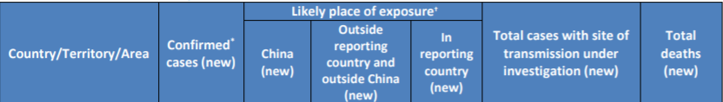
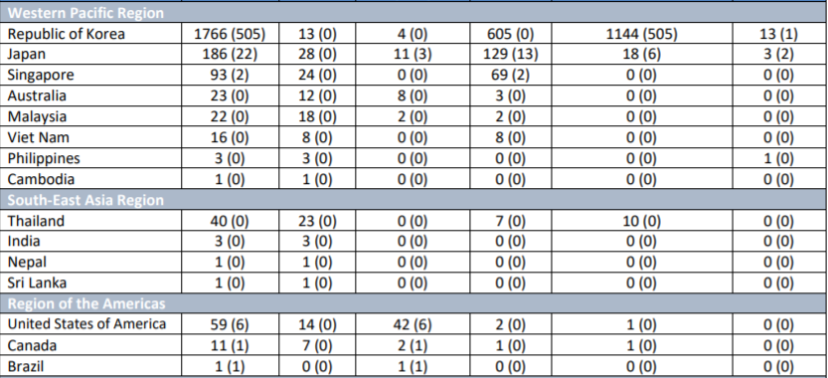
www.who.int Situation report #38 Cases by country (1)

Slide 12
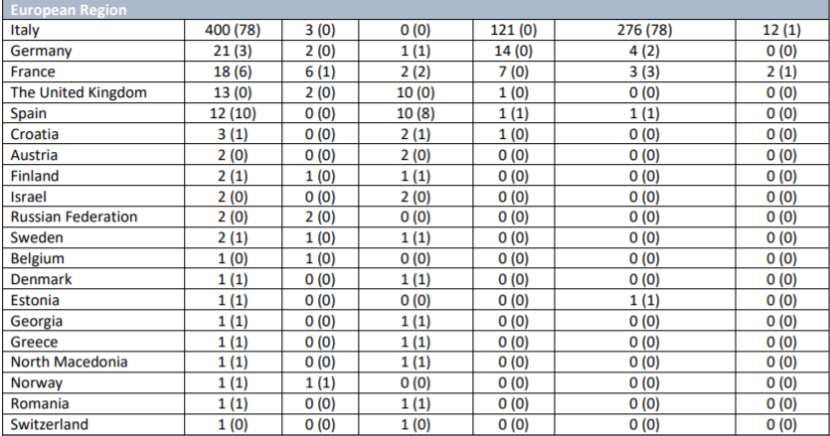
www.who.int Situation report #38 Cases by country (2)

Slide 13
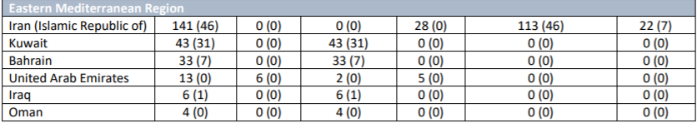
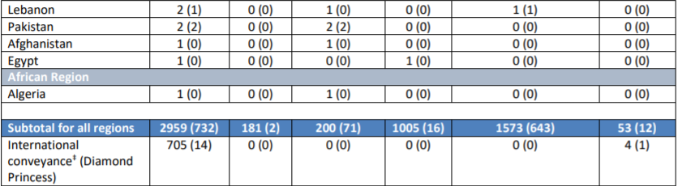
www.who.int Situation report #38 Cases by country (3)

Slide 14
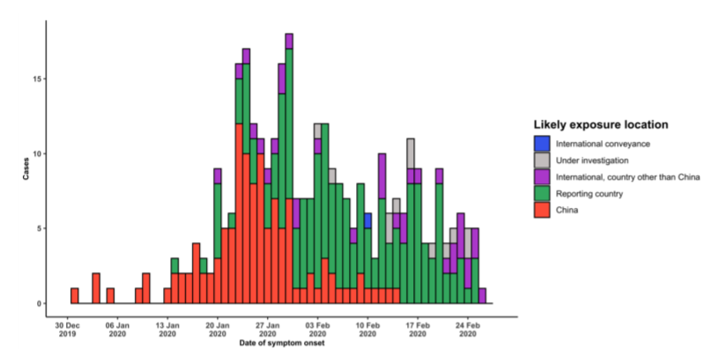
www.who.int Situation report #38 Cases Outside China
Source: WHO

Slide 15
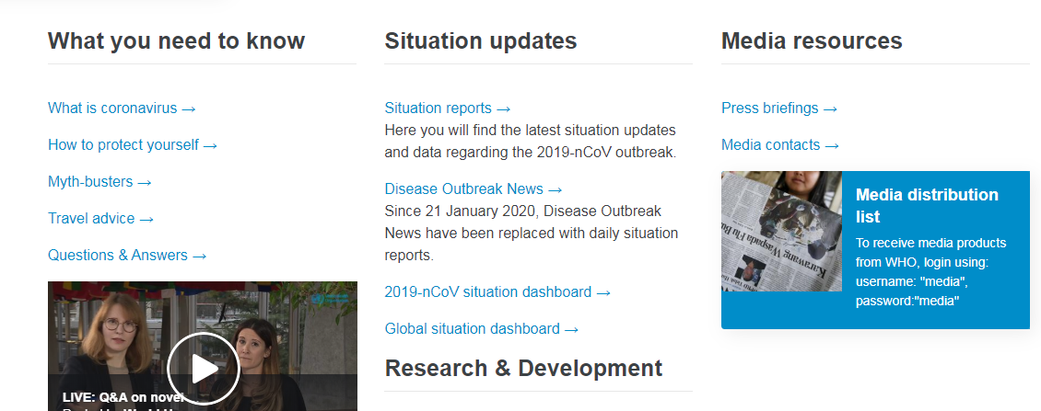
www.who.int Dashboard

Slide 16
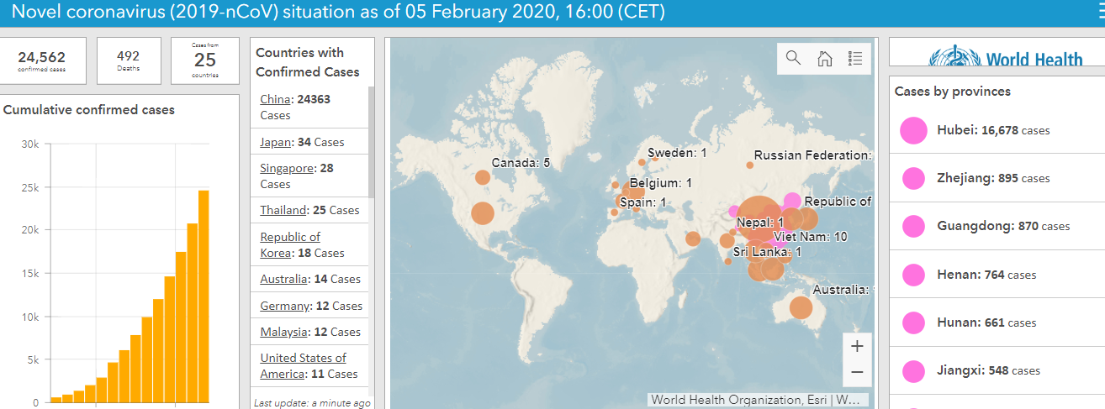
www.who.int Dashboard
http://who.maps.arcgis.com/apps/opsdashboard/index.html#/c88e37cfc43b4ed3baf977d77e4a0667

Slide 17
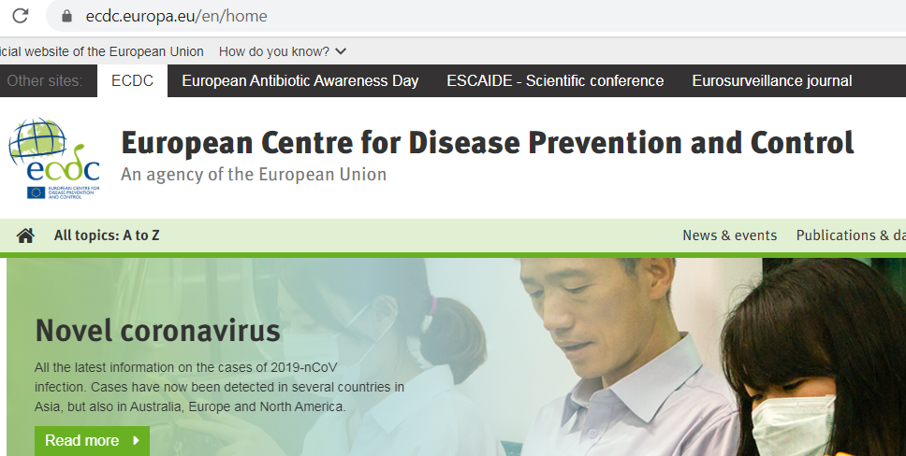
www.ecdc.europa.eu

Slide 18
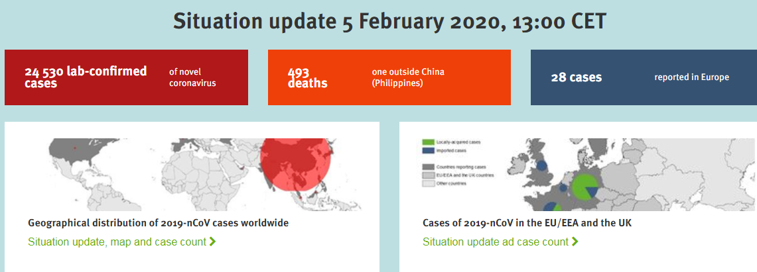
www.ecdc.europa.eu

Slide 19
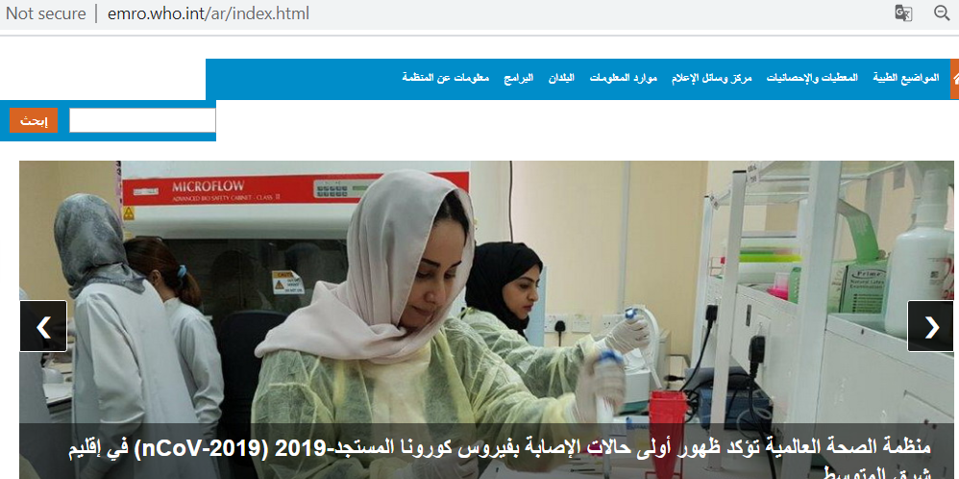
www.emro.who.int

Slide 20
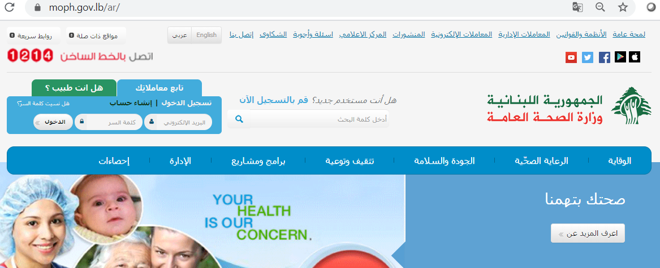
www.moph.gov.lb

Slide 21
البيانات الملحية

Slide 22
COVID-19, Lebanon, 2020 Distribution by time (date of lab results) Up to 27 Feb 2020
Date | Confirmed | Deaths
21/20/2020 | 0 | 0
22/02/2020 | 0 | 0
23/02/2020 | 0 | 0
24/02/2020 | 0 | 0
25/06/2020 | 1 | 0
27/02/2020 | 1 | 0

