Slide 1
Basic epidemiology- Surveillance

Slide 2
John Snow
1813-1858
Father of epidemiology

Slide 3
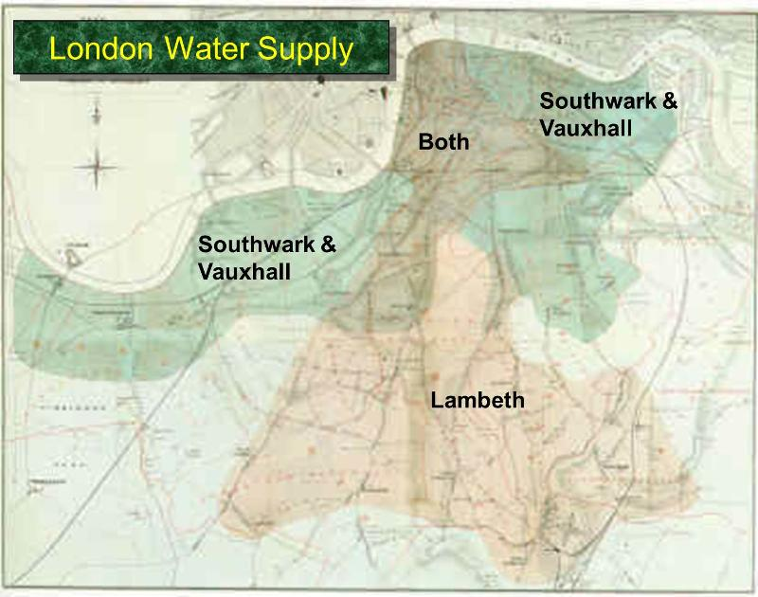
1854 outbreak
Of Cholera
London

Slide 4

315 deaths/10000 houses
From Southwork company
Vs 37/10000 from
Lamberth company

Slide 5
61/83 who died used
Water from the pump
On Broad street

Slide 6
Joseph Bazalgette
2015 marks the 150th anniversary of London’s sewerage system
Transformed public health; major role in decreasing the burden of disease
2.36 billions still live without basic sanitation
1 billion practice defecation in the open
Up to 50% of malnutrition is attributable to poor water, sanitation, and hygiene, as are many neglected tropical diseases.
  Brewer et al. Lancet 386:128; 2015

Slide 7
Pretest
Why we do surveillance
What are the three types of indicators used in healthcare settings
Structural; process; outcome indicators
Incidence; prevalence; incidence density
Difference between descriptive and analytical studies
relative risk; Confidence interval
Systematic reviews; randomized studies; observational studies; descriptive;

Slide 8
Endemic Vs. Epidemic
No. of Cases of a Disease
Endemic
Epidemic
Time

Slide 9
Definitions
Hospital surveillance is the ongoing, systematic
  collection,
  analysis,
  Interpretation,
  dissemination of health data (e.g., HAI)
to help guide clinical and public health decision-making and action (i.e., information for action).

Slide 10
Select Indicators
Prioritize which outcomes to measure in your target surveillance population
  Structure and process indicators
  Outcome indicators

Slide 11
2002: Illinois mandated reporting of HAI to state. Subsequently many states followed
2005: NNIS becomes National Healthcare Safety Network (NHSN)
The International Nosocomial Infection Control Consortium (INICC)
CMS stopped paying for many HAIs (CLABSI, SSI post CABG)
Many European countries mandate reporting

Slide 12
Surveillance
Identifying rate of complications (meaningful)
Leads to interventions (actionable)

Slide 13
Surveillance Methods
Measures
  Incidence (number of new events / number of persons at risk)
  Incidence density: risk related to exposure over time
  Prevalence (point prevalence)
Measurement
  Continuous vs periodic
  Retrospective vs prospective
  Active vs passive
Population
  Hospital-wide vs targeted

Slide 14
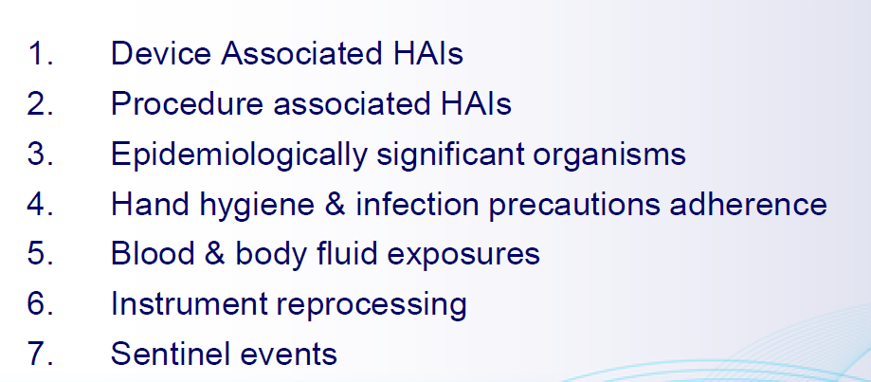
Common process and outcome measures selected for surveillance

Slide 15
- Device-Associated Infections: rate of infections per 1000 device days
(number of device-associated infections/number of device days) 1000
-Surgical Site Infections: rate of SSIs per 100 procedures
(number of SSIs/number of surgical procedures) 100
-Multidrug-Resistant Organism Infections: rate of infection per 1000 patient days
(number of infections/number of patient days) 1000
-SIR 5 Observed HAIs/Expected HAIs

Slide 16
Requirements for HAIs surveillance
Clear objectives
Case definitions
Access to information about cases (numerators) & at risk populations (denominators)
Resources
Stratification by risk
Identification of risk factors

Slide 17
Case definition
Standardized
(Consider using NHSN definition)
Clinical might be different from surveillance definition
Local: follow trend over time
Universal: allow comparison with a benchmark

Slide 18
Population at risk (denominator)
Same time every day
E.g, # of patients on ventilator, # of patients with urinary catheter
Integrate with other nursing functions

Slide 19
Data collection form
Patient demographics and basic data (age, sex, location, admission date, admission diagnosis)
HAI risk factors: DM, lung disease, cancer; devices
HAI characteristics: date, pathogen, location
Separate section for specific HAI types

Slide 20
CLABSI surveillance
Case definition: Primary laboratory confirmed BSI + Central line = CLABSI
Population at risk: Central line in place
Incidence density: CLABSI / CL-days
Risk stratification: Patient characteristics → Unit location

Slide 21
Month #of inf Cath-day Rate(per 1000)
Jan12 1.00 292.00 3.42
Feb12 1.00 314.00 3.18
Mar12 1.00 293.00 3.41
Apr12 1.00 243.00 4.12
May12 1.00 230.00 4.35
Jun12 2.00 220.00 9.09
Jul12 1.00 218.00 4.59
Aug12 2.00 202.00 9.90
Sep12 3.00 250.00 12.00
Oct12 1.00 210.00 4.76
Nov12 2.00 182.00 10.99
Dec12 2.00 181.00 11.05

Slide 22
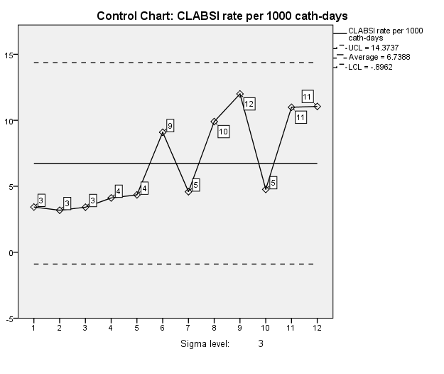

Slide 23
Reporting: Standardized Infection Ratio (SIR)
NHSN SIR = (#Observed CLABSI) / (#Expected CLABSI)
Observed = #CLABSI identified in one unit location
Expected = (mean incidence density same location all facilities) X (#central line days at reporting facility)
Ratio with 95% CI
SIR should be around 1

Slide 24
Example SIR
CLABSI rate: 8.9; # 13; catheter-days: 1463
Pooled ICU mean rate: 2.3
  Edward JR et al. AJIC 2009;37:783-805
SIR: observed CLABSI/ Expected
Observed: 13
Expected: 1463 * 2.3/1000 = 3.36
SIR = 13/3.36 =3.87
Poisson test: 0.00005

