Slide 1
Outbreak investigation; cholera

Slide 2
Pretest
What is the current case definition of cholera
What is the infectious dose in cholera
What percentage of people are symptomatic from cholera
How to disinfect water to make it bacteria-free
What is the percentage of chlorine to be used for surface disinfection

Slide 3
Outbreak
An increase in the incidence of a disease above what is normally expected.
Sometimes one case could be an outbreak (one case of cholera locally transmitted; Healthcare acquired postop strep A infection)
A cholera outbreak is defined by the occurrence of at least one confirmed case of cholera and evidence of local transmission.

Slide 4
Case presentation
50 year old Syrian man previously healthy is hospitalized with severe diarrhea
The diarrhea described as voluminous
Duration one day
The patient developed hypotension, acute renal failure and acidosis
Patient placed on IV antibiotics, IV fluids and transferred to ICU

Slide 5
Diarrhea
Acute vs persistent (>14 days)
Invasive (fever, blood, mucus) vs watery

Slide 6
Invasive diarrhea
Campylobacter
Salmonella
Shigella
Enteroinvasive e coli
Yersinia
Amebiasis (
C diff ?

Slide 7
Watery diarhea
Rotavirus in children
Calciviruses such as noroviruses (prominent vomiting)
Enterotoxigenic e coli
Other e coli
Aeromonas
Vibrio cholera
Other pathogenic vibrios

Slide 8
From 2017 to 2019, 99 countries reported at least one cholera case with local transmission to WHO, totalling more than 2∙6 million cases and over 10 000 deaths, with the majority of deaths and cases reported in Africa and the Middle East
Across six countries in sub-Saharan Africa from 2010 to 2013, case-fatality ratios varied widely from 0% to 10%,
with a median of 1%.
Lancet 2022

Slide 10
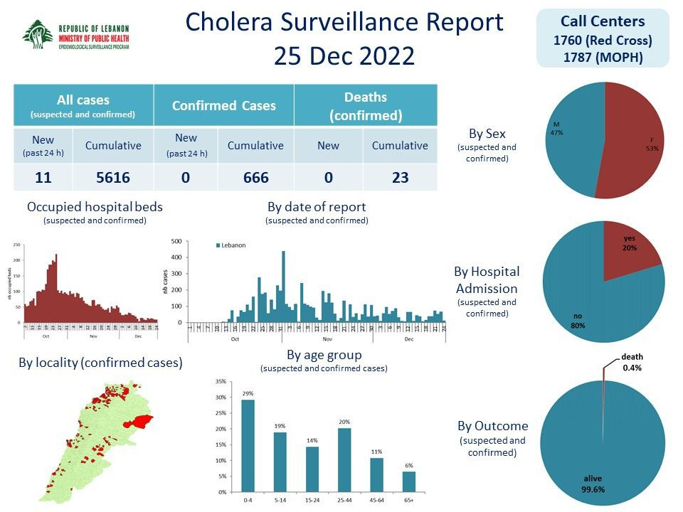

Slide 11
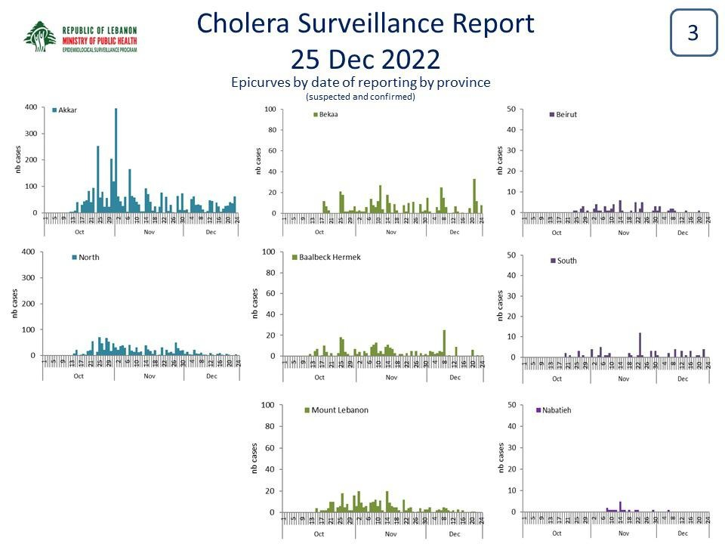

Slide 12
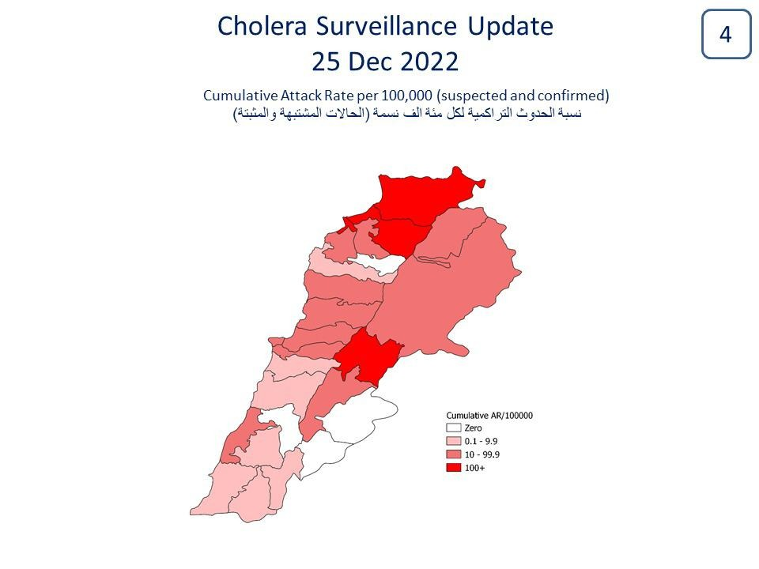

Slide 13
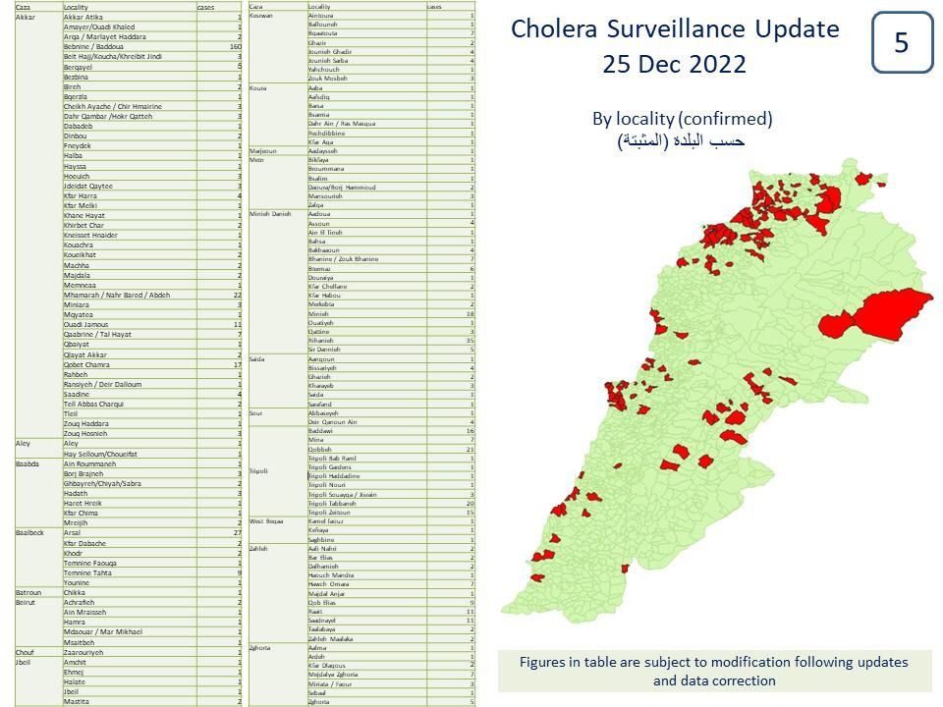

Slide 14
Initial investigation
–1.Confirm outbreak; save the specimen; Literature review (https://outbreak-database.com/Home.aspx)
–2.Case definition
–3.Case finding; Lab support
--4.Orient data into time, place, person. Epidemic curve; spot map
–5.Chart review and line list
–6.Direct Observations
--7.Develop hypothesis regarding source and mode of spread
–8. Test your hypothesis; Environmental sampling; Analytic studies
–9.Implement interim control measures
--10.Communication

Slide 15
Currently WGS
Practical Healthcare epidemiology
4th ed

Slide 16
Transmission: fecal-oral route
Food
Water
Fomite
Direct contact

Slide 17
Infectious dose
The median infectious dose is on the scale of 100 000 000 organisms
although this drops to 100–10 000 when intake is accompanied by a buffer solution, which might mimic food-borne transmission

Slide 18
Incubation: few hours to five days; usually 2 to 3 days
Period of communicability: usually few days after recovery
(carrier state may persist for many months;
Rarely chronic biliary infection lasting for years)
Majority asymptomatic
Some with mild symptoms
Severe symptoms (10%) might cause death in few hours if not rapidly treated (Cholera gravis)

Slide 20
FOr vibrio cholera we need a special media:
Thiosulfate citrate bile salts sucrose (TCBS)
Oxidase positive
Gram stain: small curved gram negative rods
Motile, comma shaped, facultative anaerobic, aquatic bacterium
Gram negative ID system
Susceptibility testing (doxycycline, azithromycine, quinolones)
Test for toxigenicity
Slide agglutination for serogroup or serotype
Cary blair transport medium
Rapid antigen test / RDTs (needs to be confirmed by culture)
PCR

Slide 21
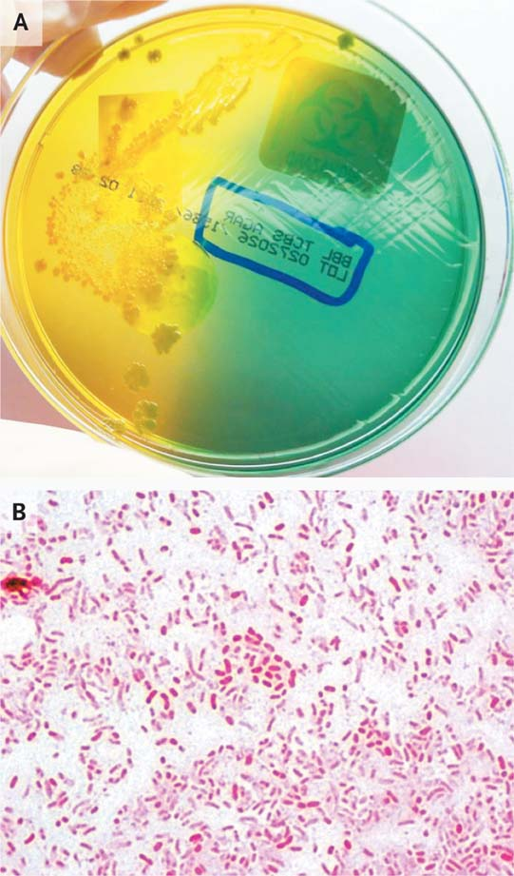

Microbiologic Studies.
Ryan ET et al. N Engl J Med 2011;364:2536-2541
Notes:
Figure 1 Microbiologic Studies. Shiny yellow colonies grew from a specimen of stool cultured on thiosulfate citrate bile salts sucrose agar, which is a selective, differential medium that supports the growth of Vibrio cholerae (Panel A). The medium is green before inoculation; sucrose-fermenting organisms such as V. cholerae turn the medium yellow. Curved gram-negative rods consistent with V. cholerae were identified on Gram's staining of one of the colonies (Panel B). Photographs courtesy of Dr. JiYeon Kim, Department of Pathology, Massachusetts General Hospital.

Slide 22
Serogroup: O1 or O139
Biotype: classical or El Tor
Serotype : Ogawa; Inoba; Hikojima
First six pandemics O1; 7th O1 ElTor biotype
O139 first detected in Indian subcontinent in 1992 and then spread to Asian countries causing large epidemics.
V cholerae O1 strains isolated between 1991 and 1994 from Bangladesh showed hybrid phenotypes of classical and El Tor strains. Consequently, these hybrid strains became dominant among the 7PET lineage with several mutations in the gene encoding the cholera toxin B subunit, ctxB. El Tor variants secrete higher amounts of cholera toxin than the original El Tor
O1 El tor Ogawa ST69

Slide 23
Kanungo S et al. Lancet 2022; 399:1429

Slide 24
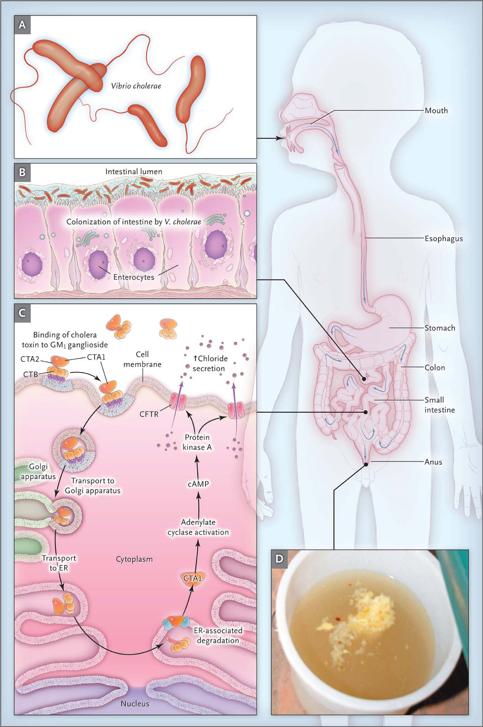
Pathogenesis of Cholera.
Harris JB et al. N Engl J Med 2011;364:2452-2461
Notes:
Figure 1 Pathogenesis of Cholera. A large inoculum must be consumed (Panel A). Most organisms are killed in the acidic environment of the stomach. In volunteers from the United States, a dose of 100 million (10⁸) to 100 billion (10¹¹) Vibrio cholerae organisms were required to produce infection.8 Organisms express the toxin coregulated pilus, a virulence factor essential for colonization of the epithelial surface of the small intestine (Panel B). V. cholerae do not invade the intestinal mucosa. Organisms express cholera toxin, an ADP-ribosylating toxin that results in increased cyclic AMP (cAMP) and chloride secretion by the apical cystic fibrosis transmembrane conductance regulator (CFTR) (Panel C). Emerging variant strains of V. cholerae O1, biotype El Tor, express the toxin that is associated with the classical biotype and appear to be more virulent than the classical biotype. As little as 5 μg of cholera toxin may mimic severe cholera. Massive fluid and electrolyte losses in the small intestine exceed the limited absorptive capacity of the colon, resulting in the purging of large quantities of “rice water” stool (Panel D). The maximal rate of purging in patients with severe cholera may exceed 10 ml per kilogram of body weight per hour. Typical rice-water stool may contain more than 10 billion (10¹⁰) organisms per milliliter.8 In addition, it appears that V. cholerae are transiently (for a period of <24 hours) more infectious to other hosts soon after passage through the intestines than are in vitro–grown bacteria, a phenotype that may facilitate the transmission of V. cholerae during epidemics. CTA1 denotes cholera toxin A1 subunit, CTA2 cholera toxin A2 subunit, CTB cholera toxin B subunit, and ER endoplasmic reticulum.

Slide 25
Various appearances of stool during cholera. Cholera stool is typically described as
having a fishy odour and “rice water” in appearance due to flecks of mucus (1) but may appear
as clear liquid (2) or greenish due to the presence of bile in the early phase of the disease (3).
Photo credit: T. Ramamurthy

Slide 26
Risk factors for severe disease
Achlorydia
O blood group
Extreme of age
High dose exposure
Partial gastrectomy

Slide 27
Immunity
high levels of protection against disease (and to a lesser extent infection and shedding) for at least 3 years after infection with a homologous serogroup.
Although longer-term data on protection from natural infection are scant, protection conferred by killed whole-cell cholera vaccination could last for at least 5 years.
Protection is serogroup specific and cross protection between O1 serotypes (Ogawa and Inaba) appears to be incomplete and asymmetric

Slide 28
Vaccine
Three types of OCV are available:
killed whole-cell vaccines (Shanchol, Shantha Biotechnics, Hyderabad, India; and Euvichol, Eubiologics, Gangwon-do, South Korea),
killed whole cell vaccine with a recombinant B subunit (Dukoral, Valneva, Sweden),
live attenuated vaccine (Vaxchora, Emergent Biosolutions, Rockville, MA, USA; table).
Shanchol and Euvichol, which have similar formulations and are WHO prequalified (table), are the two vaccines used in outbreaks and cholera-endemic countries, although these vaccines are less effective in young children (ie, younger than 5 years) . Two doses vaccine two weeks apart
Shanchol: A randomised, placebo-controlled trial in India showed that a two-dose regimen confers 67% protective efficacy against medically attended cholera within 2 years of vaccination, 66% at 3 years, and 65% at 5 years

Slide 30
Treatment
ORS
IV fluid for very severe case
Needs aggressive replacement for severe cases
Antibiotics
Zinc for children

Slide 31
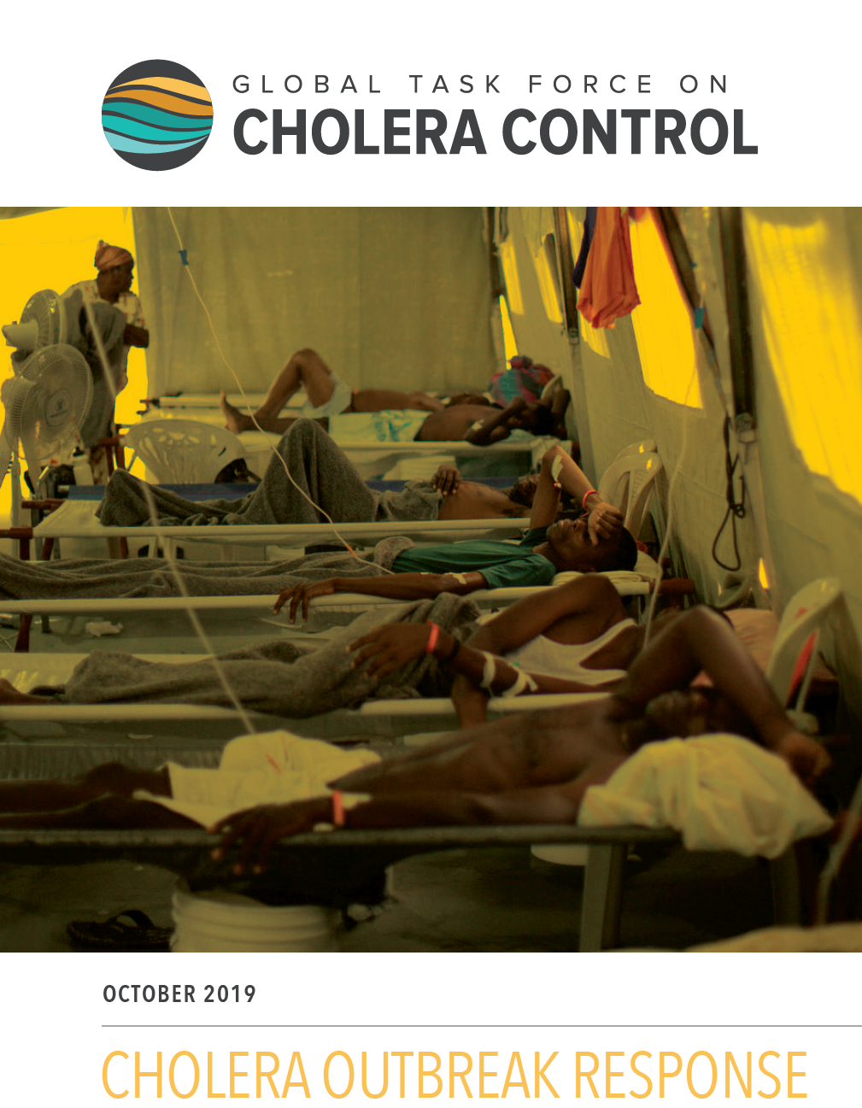

Slide 33
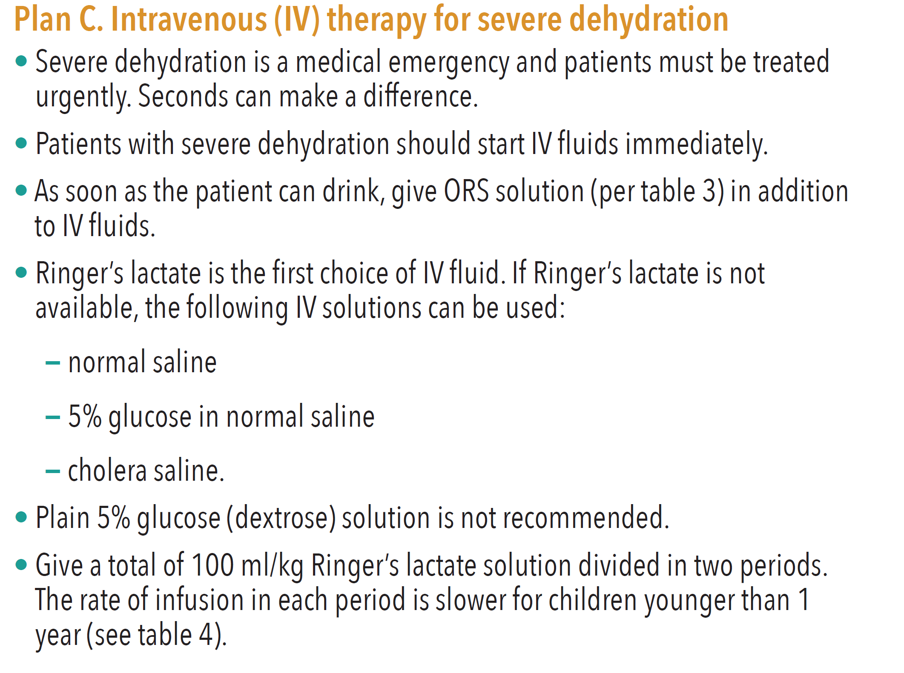

Slide 37
Control
Adequate sanitation
Safe water
Fly control
Bleach for cleaning
Add chlore to water

Slide 39
Notes:
One cup is 200 ml

Slide 40
Conclusion
Cholera outbreaks occurs in underdeveloped countries
Control:
Personal hygiene
Safe water for drinking and personal use
Safe food
Safe handling of sewage
Identify cases and hot spots
Oral vaccine
We need to act fast
Otherwise another bad epidemic

