Slide 1
Quality control; bundle based approach

Slide 2
Pretest
What is quality and how we can provide quality care to our patients
Sentinel event
Bundle approach
Name one important evidence based approach to decrease risk of:
CAUTI
VAP
CLABSI
SSI

Slide 3
To err is human (1999) Framework for quality
Safe
Timely
Effective
Efficient
Equitable
Patient centered

Slide 4
Value of care
The best quality that we are able to afford

Slide 5
High reliability organization (5 practices)
Preoccupation with failure
Reluctance to simplify interpretation
Sensitivity to operation
Commitment to resilience
Deference to expertise

Slide 9
Error “no name, no blame, no shame”
Focus on improvement of processed without negating accountability at the individual level
Most errors represent “system flaws rather than character flaws”
Swiss cheese model
PDSA
Lean (faster and more flexible to reduce waste)
Six-sigma (reduce variation; 3.4 defects per 1 million opportunities; DMAIC define; measure; analyse; improve; control)
Implementation: piloted than spread hospital wide. Perceived beneficial not to burden their daily activities. Champions
Sustainability

Slide 10
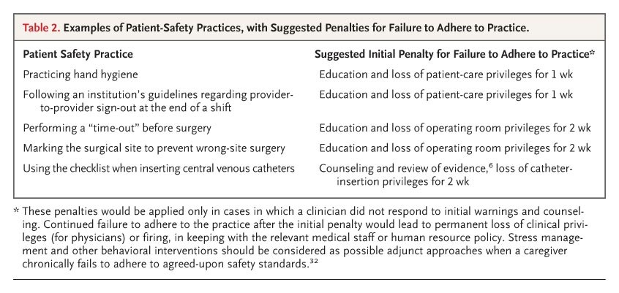

Examples of Patient-Safety Practices, with Suggested Penalties for Failure to Adhere to Practice.
Wachter RM, Pronovost PJ. N Engl J Med 2009;361:1401-1406.
Notes:
Table 2. Examples of Patient-Safety Practices, with Suggested Penalties for Failure to Adhere to Practice.

Slide 11
Atul Gawande: the checklist manifesto
Necessary faillibility (Gorovitz and MacIntyre)
Ignorance
Ineptitude: knowledge exists yet we fail to apply it consistently and correctly
Ineptitude: any endeavor requiring mastery of complexity and of large amounts of knowledge (science is complex)
Checklist
Peter Pronovost (safe patients, smart hospitals)

Slide 12
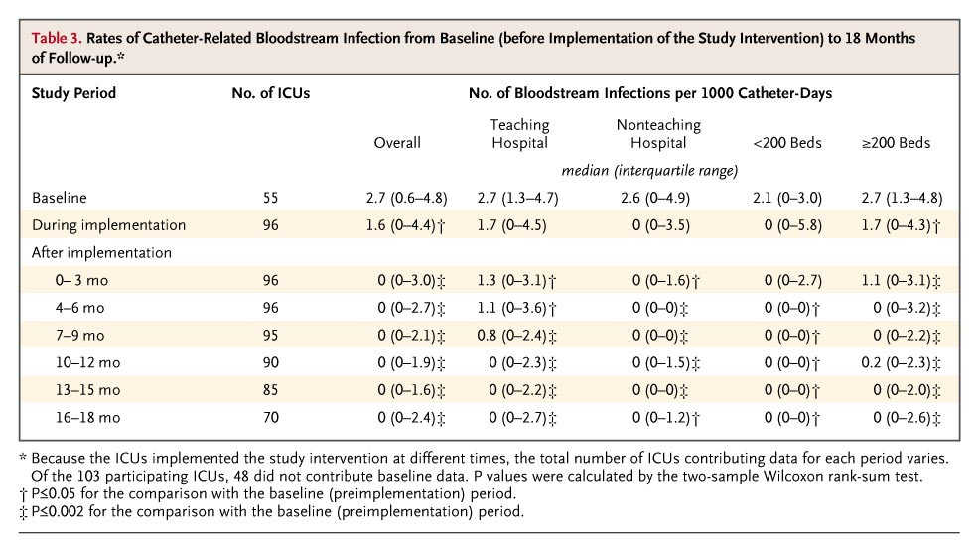

Rates of Catheter-Related Bloodstream Infection from Baseline (before Implementation of the Study Intervention) to 18 Months of Follow-up
Pronovost P et al. N Engl J Med 2006;355:2725-2732
Notes:
Table 3. Rates of Catheter-Related Bloodstream Infection from Baseline (before Implementation of the Study Intervention) to 18 Months of Follow-up.

Slide 13
Bundles:Definition
Care “bundles” are simple sets of :
evidence-based practices that,
when implemented collectively,
improve the reliability of their delivery and
improve patient outcomes.

Slide 14
CAUTI
UTI is one of the most common HAI
70-80% attributable to an indwelling urethral catheter
12-16% of hospitalized patients will have a urinary catheter
Daily risk of bacteriuria 3-7%
2011 NHSN: 0.2-4.8 per 1000 catheter-days
21% of all nosocomial BSIs (Canadian data; Fortin et al ICHE 2012)
Non-infectious complications are common (inflammation, strictures)

Slide 15
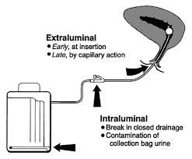

Slide 16
All of the followings are accepted indications for urinary catheter except
Periop use for selected surgical procedures
Accurate output in critical patients
Urinary retention and obstruction
Assistance of healing of open pressure ulcers in incontinent patients
At patient request to improve comfort (eg, end of life care)

Slide 17
Appropriate technique for catheter insertion; all true except
Consider other methods such as intermittent catheterization
Insert catheters following aseptic technique and using sterile equipment
Use sterile gloves, drape, and sponges; an antiseptic solution for cleaning the urethral meatus. Sterile single-use packet of lubricant jelly
Use as large catheter as possible

Slide 18
Appropriate technique for catheter maintenance; all true except
Properly secure indwelling catheter
Maintain unobstructed urine flow
Clean the meatal area with antiseptic solutions
For examination of fresh urine, aspirate the urine from the needleless sampling port
Maintain a sterile continuously closed drainage system

Slide 19
Preventing SSI; basic practices
Antimicrobial prophylaxis: choice, timing, duration, dosing, re-dose for long procedures
Do not remove hair unless it interfere with the operation; use clipper no razor
Control blood glucose during the postop period
Maintain perioperative normothermia (temp ≥ 35.5°C)
Administer supplemental oxygen for procedures involving mechanical ventilation
Use an alcohol-containing preop skin prep agent
Use impervious plastic wound protectors for GI and biliary tract surgery
Use a surgical safety checklist (WHO 19 items)

Slide 21
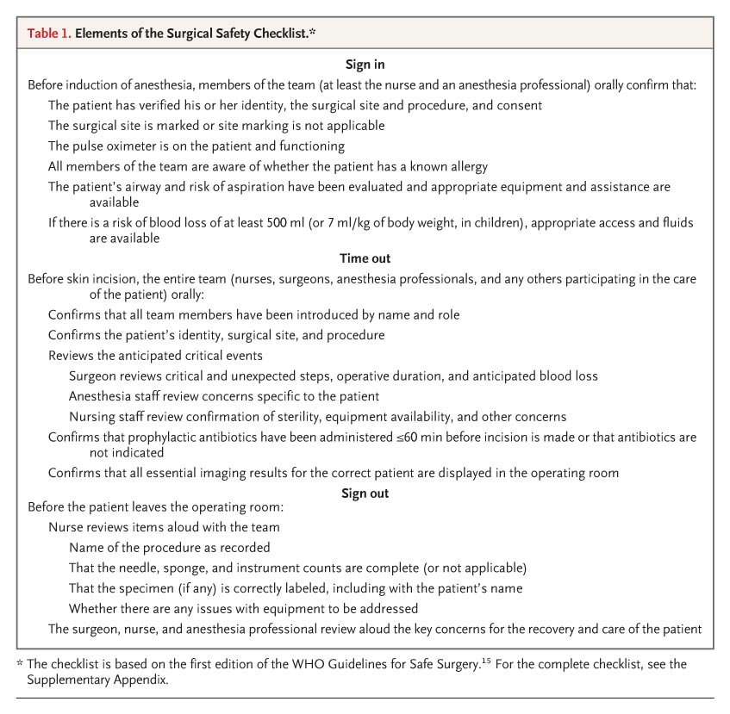
Elements of the Surgical Safety Checklist
Haynes AB et al. N Engl J Med 2009;360:491-499
Notes:
Table 1. Elements of the Surgical Safety Checklist.

Slide 22
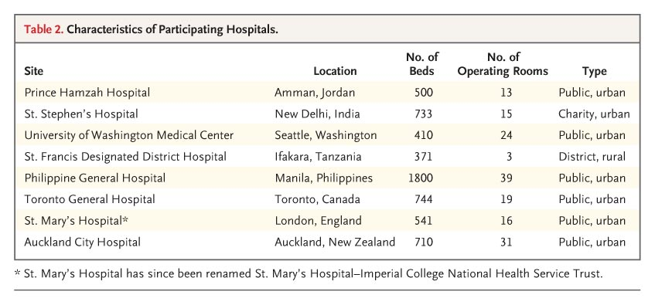
Characteristics of Participating Hospitals
Haynes AB et al. N Engl J Med 2009;360:491-499
Notes:
Table 2. Characteristics of Participating Hospitals.

Slide 23
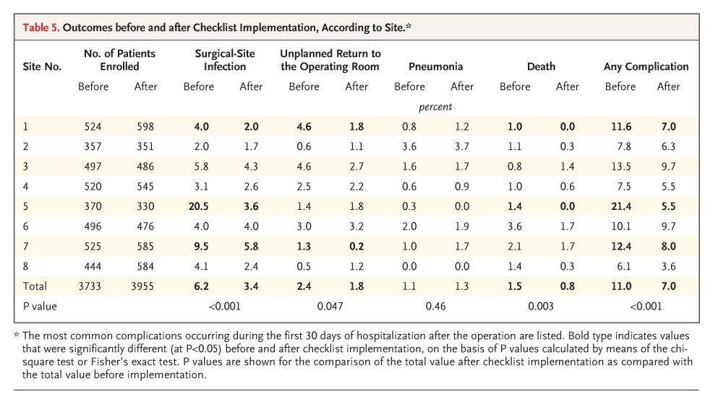
Outcomes before and after Checklist Implementation, According to Site
Haynes AB et al. N Engl J Med 2009;360:491-499
Notes:
Table 5. Outcomes before and after Checklist Implementation, According to Site.

Slide 24
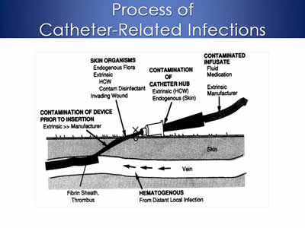

Slide 25
CLABSI Prevention Bundle: Insertion Bundle
Hand hygiene
Maximal sterile barrier precautions upon insertion:
surgical mask,
sterile gloves,
cap,
sterile gown,
large sterile drape.
Skin cleaning with alcohol-based chlorhexidine (rather than iodine).
Optimal catheter selection;
Avoidance of the femoral vein for central venous access in adult patients.
Use of subclavian rather than jugular veins.

Slide 26
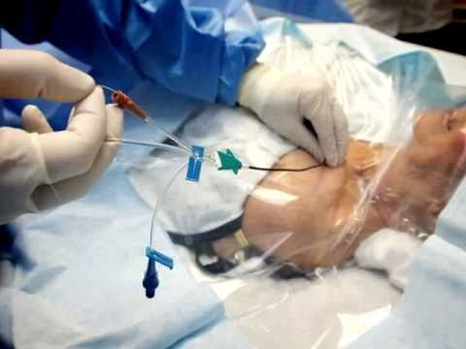

Slide 27
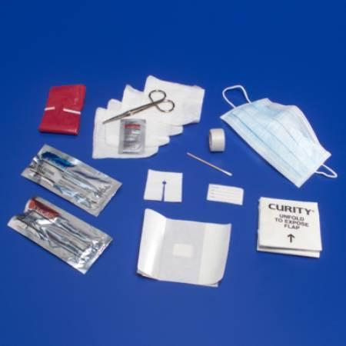
All inclusive central line kit or cart

Slide 28
Preventing VAP; basic practices
Use non-invasive positive pressure ventilation (NIPPV) whenever feasible
Interrupt sedation once a day
Assess readiness to extubate once a day
Provide early exercise and mobilization
Elevate the head of the bed to 30-45°
Provide endotracheal tubes with subglottic secretion drainage ports for patients likely to require more than 48-72 hrs of intubation

Slide 29
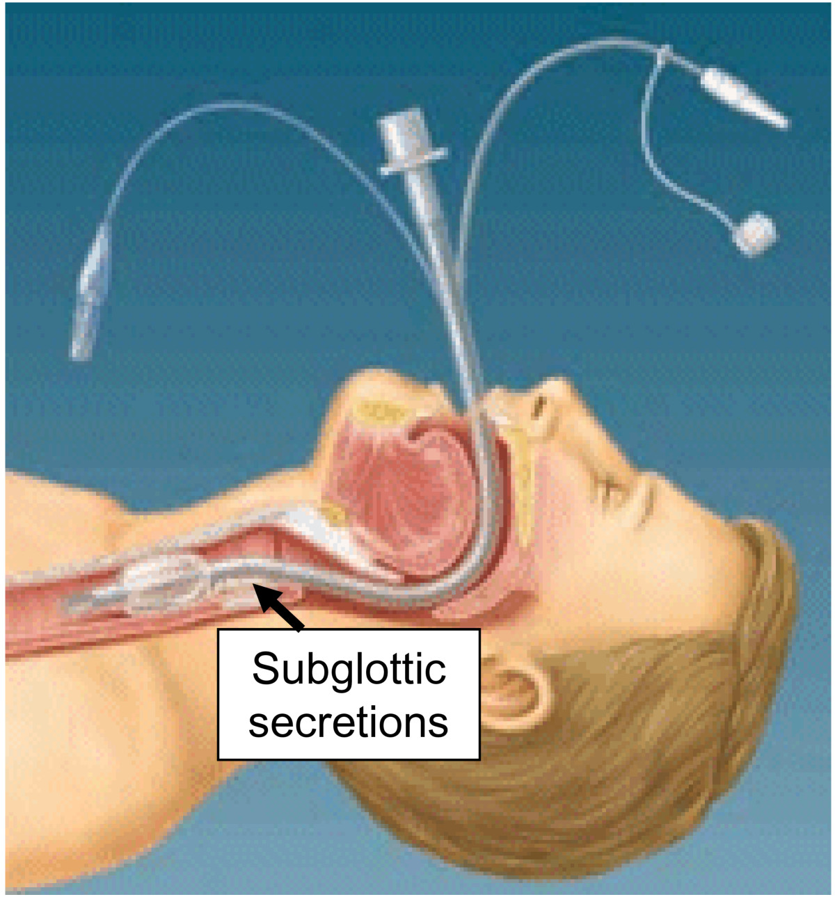

Slide 30
Translating evidence into practice
Technical work: summaries, policies, protocols, bundles, checklists
Bundle: grouping of evidenced-based practices that individually improve care
Adaptive work: values, attitudes, beliefs and behaviors

Slide 31
Conclusion
Implementation of the guidelines leads to:
Improvements in hospitals infection rates
Lower healthcare costs
Enhance the quality of healthcare for our patients

Slide 32
Avedis Donabedian 1919-2000
Pioneer of quality in healthcare and medical outcome research
Triade of outcome, process, and structure as a model for evaluating medical care.
“Systems awareness and systems design are important for healthcare professionals but are not enough. They are enabling mechanisms only. It is the ethical dimension of individuals that is essential to a system’s success. Ultimately the secret of quality is love.”

