Slide 1
IPC strategy
Standard and transmission based precautions

Slide 2
Pretest
Do you have an IPC committee that meets regularly
What are the 8 elets of standard precautions
Do you practice consistently the six steps of hand hygiene
What is better hydroalcoholic hand rub or soap and water
Sequence of PPE removal
Can droplet transmission become airborne
What organisms might cause problem if they stay in the environment
Classify the following organisms from easier to more difficult to kill with disinfectants: adenovirus; cholera; SARS2 (covid19); norovirus

Slide 3
Mode of transmission of Infectious agents
Contact
  Direct
  Indirect
Droplet
Airborne
Endogenous
Common source
Vector borne

Slide 4
Increasing order of resistance to disinfection
Lipid or medium sized viruses
Vegetative bacteria
Fungi
Nonlipid or small viruses
Mycobacteria
Coccidia (Cryptosporidium)
Bacterial spores
Prions

Slide 5
Characteristics of the agents
Infectivity – ability to invade a host
  (# infected / # susceptible) X 100
Pathogenicity – ability to cause disease
  (# with clinical disease / # of infected) X 100
Virulence – ability to cause death
  (# of deaths / # with disease (cases)) X 100
Immunogenicity; Toxigenicity; Resistance
Colonization: presence of an agent on a mucosal surface without an apparent host reaction.

Slide 6
Host defenses
Specific
  Humoral
  Cell mediated immunity
Nonspecific
  Skin and mucous membranes
  Acidity, Immunoglobulins, enzymes
  Leukocytes, complements, cytokines (IL1, IL2, TNF, IFN)
  Normal bacterial flora

Slide 7
Incubation Period
The interval between the time of contact and/or entry of the agent and onset of illness.
Depends on multiple factors:
  Characteristic of the agent
  Dosage of the infectious agent
  Portal of entry
  Immune response of the host

Slide 8
Herd Immunity
The decreased probability that a group will develop an epidemic because the proportion of immune individuals reduces the chance of contact between infected and susceptible persons

Slide 9
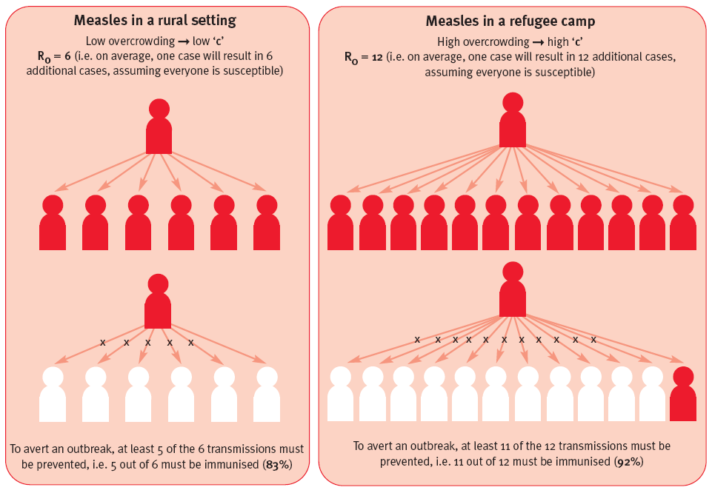

Vaccination issues

Slide 10
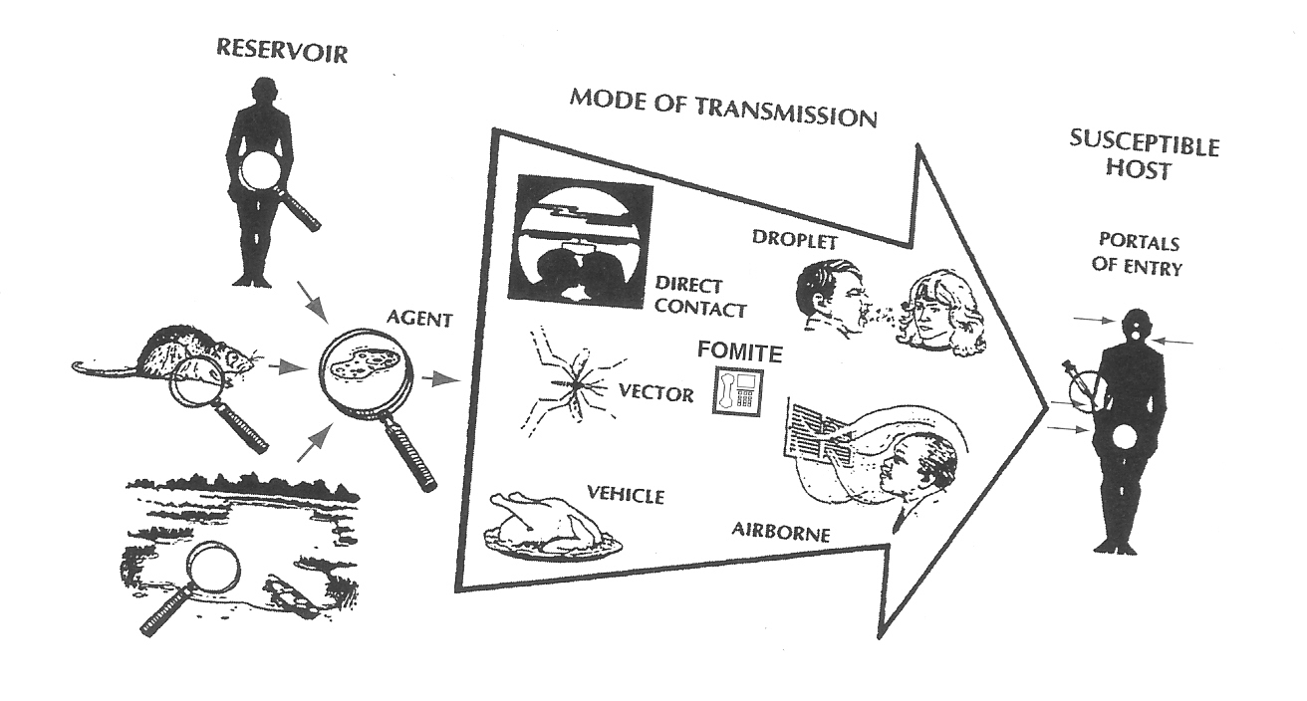
Chain of infection

Slide 11
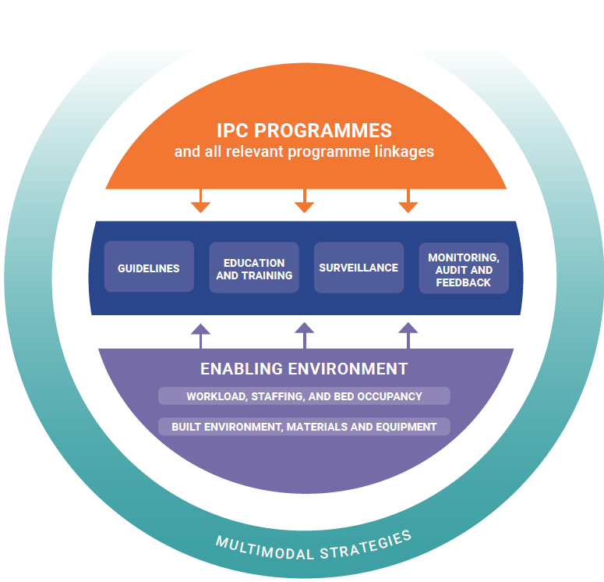
WHO core components of IPC programs

Slide 13
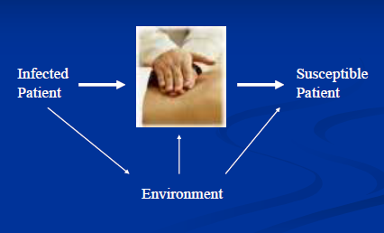
Medical Equipment

Slide 14
Standard Precautions: 8 elements
Hand Hygiene
PPE use according to risk of exposure
Respiratory Hygiene (cough etiquette)
Safe injections practices, sharp management and injury prevention
Disinfection and sterilization principles: patient care equipment
Environmental cleaning and cleaning blood spills
Safe handling of soiled linen/food services
Waste Management

Slide 16
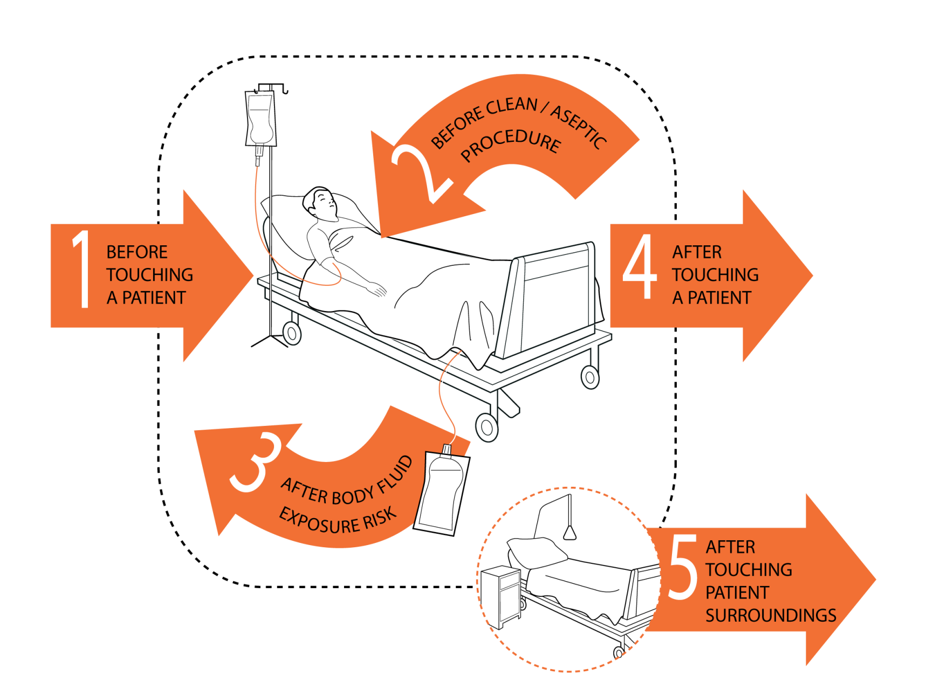
Hand Hygiene - 5 Moments Approach

Slide 17
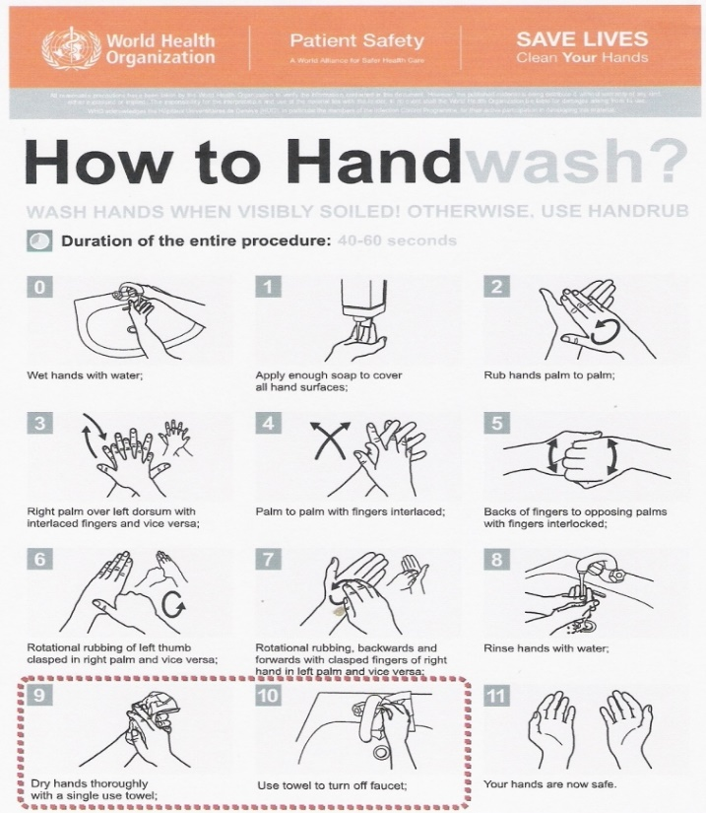
Hand Washing with soap and water
Hand washing with soap and water using liquid hands antiseptic/cleanser
  40 sec to 1 min duration
  Scrub palms, backs, webs, nails
  Always use if visible soil on hands
  After caring for a person with known or suspected infectious diarrhea
    Effective against spore forming
    organisms such as C. difficile spores
    Follow steps at all times

Slide 18
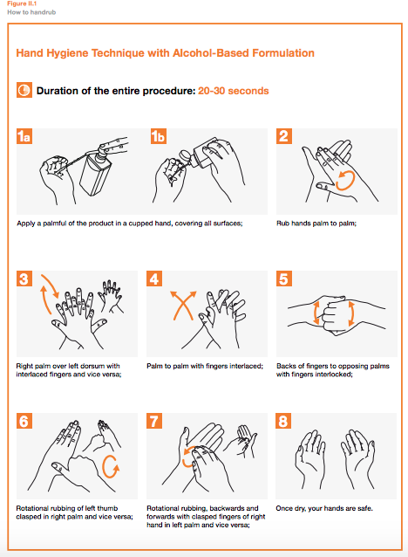
Hand Rubbing with alcohol-based
Hand Rubbing with antiseptics
Ethanol or propanol 60- 80% concentration
  Use adequate amount
  20-30 seconds duration or until dry
  Scrub palms, backs, webs, nails
  Rapid activity- wide spectrum – short duration
  Needs to be repeated frequently
  Chlorhexidine Gluconate can potentiate effect
  More accessible than sinks
  Improve compliance
  Not effective against spores
    Follow steps at all times

Slide 20
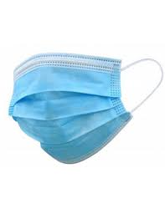
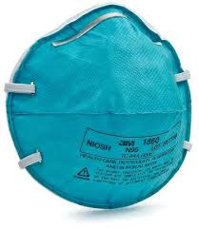
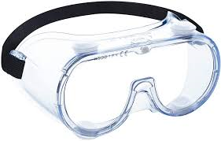
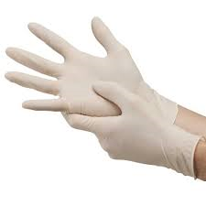

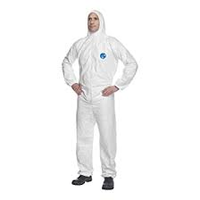
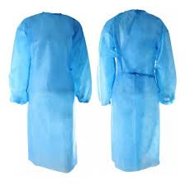
PPE use: Depending on the RISK
Standard Precautions #2

Slide 21
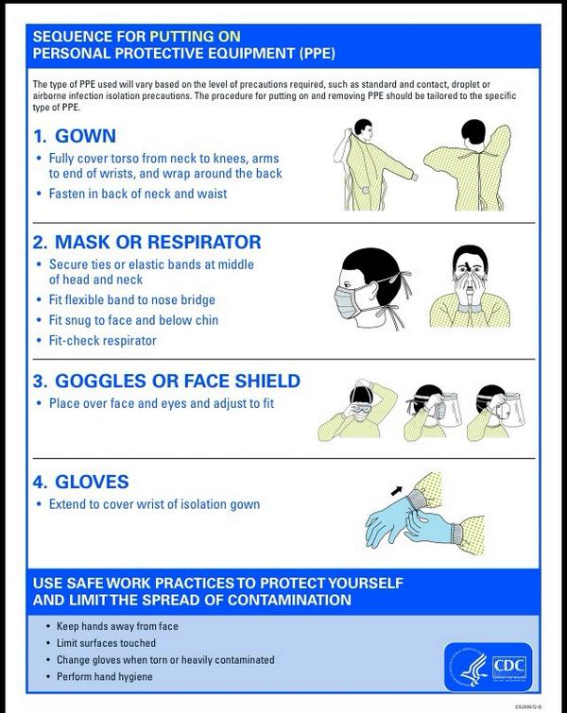
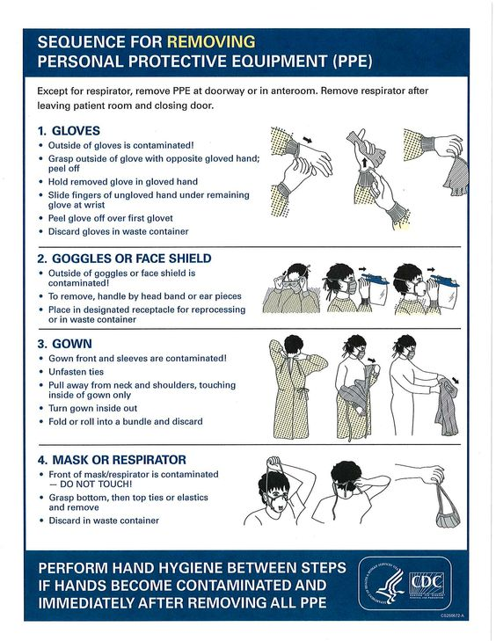
Sequence of using PPE

Slide 22
PPE Sequence Matters
Donning
Removing
Gown first
Mask or respirator
Goggles or face shield
Gloves
Gloves
Face shield or goggles
Gown
Mask or respirator
Hand Hygiene between each step

Slide 25
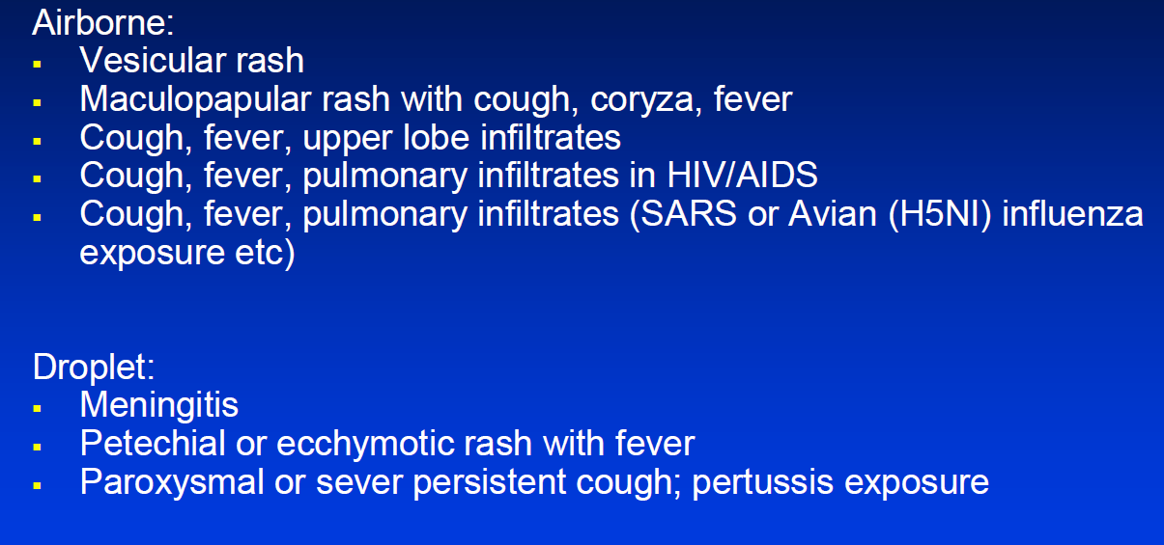
Syndromic precautions

Slide 26
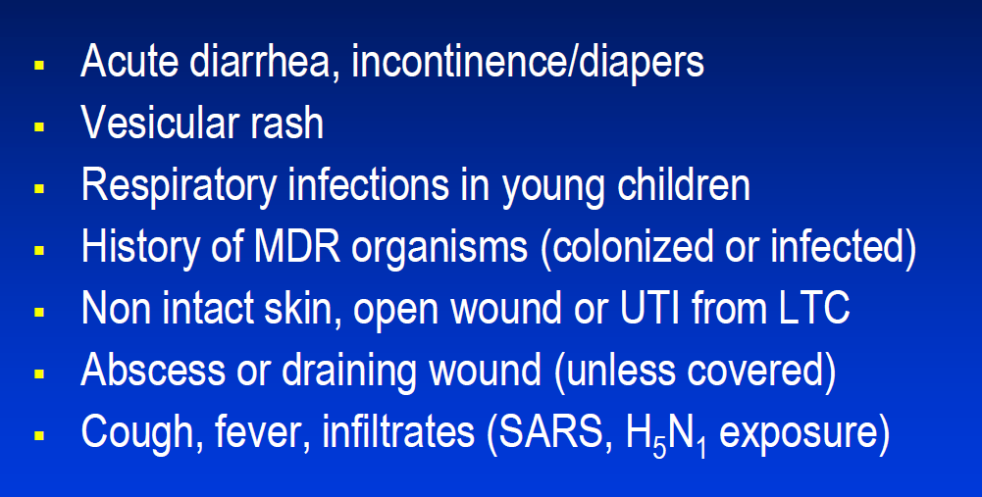
Syndromic contact precautions

Slide 27
Aerosol-generating procedures
Endotracheal intubation
Nebulized medication
Bronchoscopy
Airway suctioning
Tracheostomy care
Chest PT
Nasopharyngeal aspiration
Positive pressure ventilation
Resiscitation manoeuvres
Postmortem excision of lung tissue

Slide 28
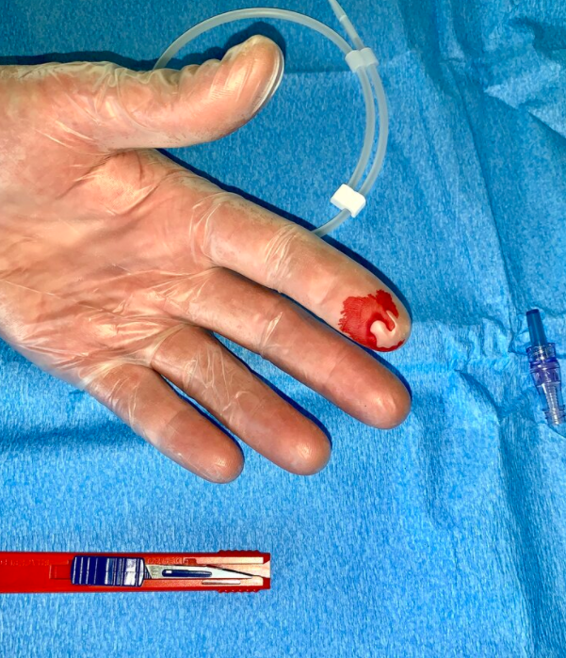
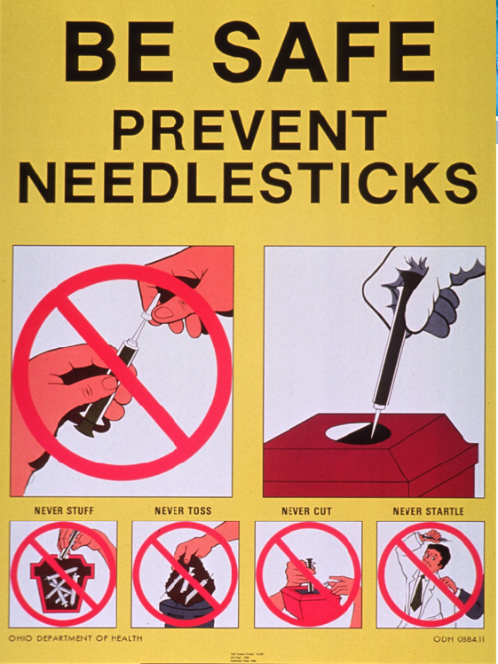
Needle Stick Injury prevention
Standard Precautions #4
Used to prevent exposure to blood borne pathogens: Hepatitis B, hep C, HIV
Do not recap needles
Do not use one hand technique to recap a needle
Wear gloves when performing injections
Do not carry contaminated needles; use forceps if necessary
Always discard needles in puncture-resistant containers– discard when ¾ full
Always report even if source is unknown
Wear PPE as part of risk assessment for potential exposure to blood and body fluids
Visual Reminders in workplace

Slide 29
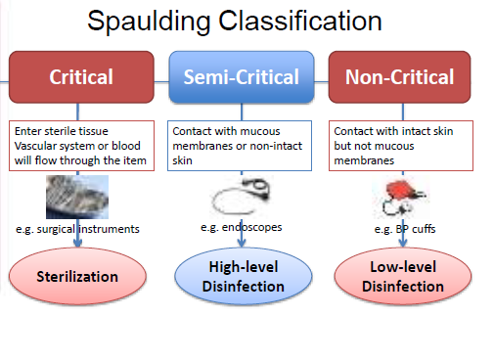

Slide 31
Duodenoscopes (ERCP): CRE outbreaks 2015
Needs special emphasis
High contamination no margin of safety
Complex; narrow channels; biofilms
Updated guidelines
Small bristle cleaning brush and additional flushing and cleaning steps of the elevator channel
periodic microbiologic surveillance
Ethylene oxide (ETO) sterilization after high level disinfection
Double high level disinfection
Peracitic acid

Slide 32
Perfusion of high level disinfectant into the channels of cystoscope not just immersion

Slide 33
Reuse of single use devices pose a significant risk for patients
Specific policies and procedures should govern this issue

Slide 34
Storage of Semicritical items
  Packaged (plastic bag e.g., laryngoscope
  Tagged (e.g., green vs red for not processed

Slide 35
Important pathogens that might contaminate the physical environment
Acinetobacter
MRSA
VRE
Clostridium difficile
Rotavirus

Slide 36
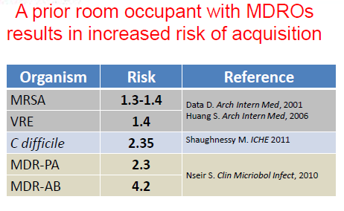

Slide 37
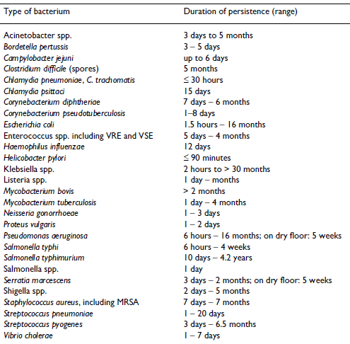




Persistence of clinically relevant bacteria on dry inanimate surfaces
Kramer et al. BMC Infectious Diseases 2006

Slide 38
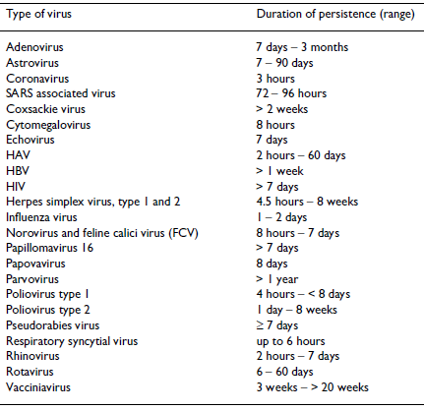
Kramer et al. BMC Infectious Diseases 2006

Slide 39

Overall, a high inoculum of the nosocomial pathogen in a cold room with high relative humidity will have the best chance for long persistence.
  Kramer et al. How long do nosocomial pathogens persist on inanimate surfaces? A systematic review. BMC infectious Disease 2006

Slide 40
Dry vs moist
Dry conditions favor the persistence of gram-positive cocci (e.g., coagulase-negative Staphylococcus spp.) in dust and on surfaces
Moist, soiled environments favor the growth and persistence of gram-negative bacilli (even very little organic material).
Fungi are also present on dust and proliferate in moist, fibrous material.
Fabric surfaces are a special concern: Fibers in carpets, furniture upholstery and window treatments

Slide 41
C diff
1: 10 dilution of bleach for c diff

Slide 42
Contamination of high touch objects
Bed rail
Tray table
Chair
IV pole
Room light switch
TV remote
Room sink
Call box/button
Room doorknob
Bedside telephone
Bathroom hand rail
Toilet flush handle
Bathroom sink
Toilet/Commode seat

Slide 43
How to monitor surface cleanliness
Inspection
Microbiological culture
Fluorescent invisible markings (fluoresces when exposed to UV light)
ATP bioluminescence (measure organic debris not a reliable indicator of microbial contamination)

Slide 44
3 ways to reduce transmission of environmental pathogens
Enhance environmental cleaning
No-touch cleaning methods (UV light; hydrogen peroxide vapor/mist)
Self-disinfecting surfaces

Slide 46
How to limit HAIs
Adherence to hand hygiene (5 opportunities)
  Correct performance of hand hygiene
  Hand rub vs hand wash
Use appropriate isolation precautions
Ensure adequate cleaning of environment
  Fluorescent marker
Ensure adequate cleaning and disinfection of medical equipment
Remove non-essential invasive medical device promptly
Avoid misuse of antimicrobials

Slide 47
Posttest
What are the 8 elets of standard precautions
Do you practice consistently the six steps of hand hygiene
What is better hydroalcoholic hand rub or soap and water
Sequence of PPE removal
Can droplet transmission becomes airborne
What organisms might cause problem if they stay in the environment
What organisms are more difficult to remove: adenovirus; cholera; SARS2 (covid19); norovirus

