Slide 1


Hospital pharmacy Quality control
Pharmacy Manual
Presented by:
Rana Itani; Rph, Hospital Pharmacist- RHUH
Mona Baalbaki; Rph, Head of Pharmacy - RHUH

Slide 2
The Purpose of the Manual
The pharmacy manual is designed to be a reference for all Hospital staff in order to identify:
&
Insure Safe and accurate medication ordering, preparation, distribution and control
Pharmacy Policies & Procedures
Operational Responsibilities
Departmental Relationships

Slide 3

PHARMACY MANUAL
The Pharmacy Manual is reviewed annually and whenever needed for any kind of modification.

Slide 4
How to design your own Pharmacy Manual?

Slide 5
Pharmacy Manual Includes all the following
Hospital Organization.
Pharmacy Department Functions.
Services provided.
Pharmacy Organization.
Human resources Functions.
Safety and occupational Hazards.

Slide 6
Hospital Organization Functional Organization of the hospital
RHUH is a university hospital providing services for several nursing units
PHARMACY
ICU
CCU
Oncology
Surgery
Pediatrics
OBS & GYN
Supportive Services: Blood bank, Radiology, Dietitians, Nursing…

Slide 7
Hospital Organization organizational Chart of hospital
Information Technology
Finance & Admin.
Internal audit
Nursing
Material & Purchasing
- Biomedical
- Eng. & Maint.
- Material Mngt
- Logistics
- HR
- Finance
Management
Pharmacy

Slide 8
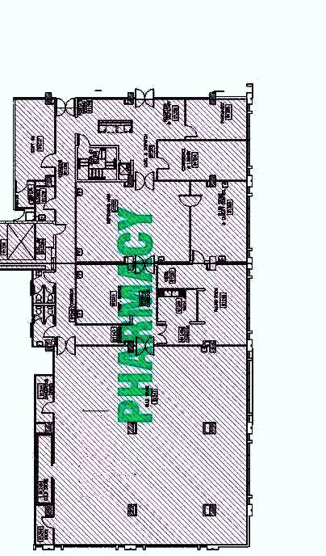
Hospital Organization
• Pharmacy Map:
A-Reception
B&C offices for pharmacy staff
E-Purchasing office
D&F- Dispensing room
G- Compounding room
H- Pharmacy store
I- WC
J- Changing room
K- Library
L- Kitchen
Head of pharmacy office is located in the ground floor.

Slide 9
Pharmacy Department Functions
Pharmacy Mission.
Pharmacy Vision.
Pharmacy Philosophy.
Pharmacy Goals and Objectives.
Code of Ethics.

Slide 10
Services Provided
Central IV Admixture Unit
Total Parenteral Nutrition Unit
Chemotherapy Unit
Dispensing by Unit Dose System

Slide 11
Pharmacy Organization
Functional Organization of the pharmacy
Location & Pharmacy Extensions
Operating Hours
Personnel
Job Description
Responsibility & duties
General rules & Regulations

Slide 12
Pharmacy Organization Functional Organization of the Pharmacy
Head of Pharmacy
Purchasing Team
Acting Supervisor Oncology team
Oncology Pharmacists
Assistant OP
Oncology Technicians
Acting Supervisor
Pharmacists
Pharmacist Assistants
Pharmacy Technicians

Slide 13
Pharmacy Organization Location and Pharmacy Extensions
The main pharmacy is located in the basement of the hospital. It consists of the following areas:
Reception and Secretary → 1190
Library → 1198
Pharmacists Office → 1192, 1193, 1194, 1195, 1197
Chemotherapy Preparation Unit → 1937
Drug preparation/ Dispensing Area → 1196

Slide 14
Pharmacy Organization Operating Hours & Personnel
Operating hours
8-7 during the week
8-4 on Saturdays
8-3 on Sundays
The pharmacy Staff should be sufficient to meet goals and objective of RHUH hospital

Slide 15
Pharmacy organization After Pharmacy Opening Hours
Nursing Units → Emergency carriage & floor stock (replenished daily).
Pharmacist On-Call is available after closing hours.
Nursing and medical staff is are informed by a memo of the pharmacist on-call during pharmacy closing hours.
Pharmacy on call sheet should be filled including dispensed medication and duration of dispensing.

Slide 16
Pharmacy Organization Responsibilities & Duties
Head of pharmacy
Pharmacist-Oncology Pharmacist
Pharmacy Technician Oncology Technician
Pharmacy Secretary

Slide 17
Pharmacy Organization Responsibilities & Duties
e.g. Head of Pharmacy
Specifying all duties assigned to the assistant of the head, supervisor pharmacists, pharmacist, assistant pharmacist, technician, secretary.
- Formulating and applying pharmacy policies.
- Updating hospital formulary.
- Controlling stock level.
- Intervening in any medical or pharmaceutical problem.

Slide 18
Pharmacy Organization General Rules & Regulations
e.g.
Pharmacy Rooms should be clean at all times.
Offices should be organized especially before leaving.
e.g.
Lab coats should be worn without exceptions.
The schedule work time should be requested.
e.g.
Work hours in holidays are rewarded in a similar manner within a month.
Pharmacist on-call should be available after closing hours to provide life-saving medications.

Slide 19
Human Resources Functions
Performance Appraisal
Student Mentorship
Orientation
Continuing Educations

Slide 20
Human Resources Functions Orientation
New employees should go through a general hospital orientation to introduce them to hospital organization as well as rules & regulations.
Interdepartmental competency orientation checklist is filled for each new employee.
Done during 3 month probation period.
A copy is sent to he HR department.

Slide 21
Human Resources Functions Performance Appraisal
Regular evaluation of personnel
Annual competency validation plan
Performance appraisal is done q 6 month & retraining is done regularly.
Anecdotal Report
Employee of the month

Slide 22
Human Resources Functions Continuing Education
Pharmaceutical & Medical lectures
Competency tests & Quizzes
Interventions & monthly Roundtables
In-service Education program

Slide 23
Human Resources Functions Student/Training Mentorship
Students from all universities
Approval form university & Head
Training Application
Training Certificate

Slide 24
Safety and Occupational hazards
Cytotoxic/Anti-Neoplastic Drugs
Personal preparation Protective Equipments.
Preparation Equipments.
Handling vials.
Handling ampoules.
Waste Disposal.
Spills.
Medical. surveillance
Preparation Area.
Drug Preparation:
Work Practices in the preparation:

Slide 25
Safety and Occupational hazards
Glass ware Safety
Use a dustpan and brush to pick up broken glass.
Hazardous Drug Safety
Hazardous materials include chemotherapeutic agents, strong acids or alkali, Corrosives, flammable items, poisonous items, human serum derived drugs, Infectious agents
Discard broken glass in a rigid container separate from regular garbage (label).

Slide 26
Safety and Occupational hazards
General Safety
No smoking, running or jumping shall be permitted.
Preventing Fire
Minimize the quantity of flammable liquids kept in the pharmacy.
Dressing shall be in accordance with policy.
Keep exits and passages clear at all times.
Keep flammable liquids in approved flammable liquid storage cabinets.

Slide 27
Safety and Occupational hazards
Treating Fire
Immediately activate the building fire alarm system.
Electrical Safety
All electrical equipments should be wired with a grounding plug.
Learn how to use extinguisher.
Do not use elevators; use building stairs.
Electrical cords or other lines shall not be suspended unsupported across rooms or passageways.

Slide 28
Safety and Occupational hazards
Medical Emergencies
Prevention of injuries should be a major emphasis of pharmacy safety program.
Proper training will prevent injuries from glassware, hazardous material, burns and electrical shock.
First aid should be provided immediately.

Slide 29
THANK YOU…

